Slide 1
THE C of I PARISH TRUSTEES & CHARITY GOVERNANCE
Janet Maxwell – Head of Synod Services & Communications

Slide 2
Good governance, integrity and Christian witness
What’s happened in the world of charities?
Charities legislation UK & Ireland - modernised in the last 20 years
Two Regulators
Charity Commission for Northern Ireland
Charities Regulatory Authority (Republic of Ireland)
A Register
A reporting system

Slide 3
From a Church of Ireland perspective
Vocabulary- Trustees
Who are trustees?
Members of Select Vestries
Members of Diocesan Councils
Members of the Representative Church Body
General Vestries, Diocesan Synods, General Synods are like stakeholders, or shareholders. They can vote on policy, but they aren’t responsible for holding the assets or for day-to-day management decisions.

Slide 4
From a Church of Ireland perspective
What else is new?
Nothing
New vocabulary, same old responsibilities
New format, same old rules
Most Select Vestries, Dioceses and the RB are already compliant
Structure – 1871 - Strong governance and integrity are a good starting point for Christian witness.

Slide 5
From a Church of Ireland perspective
Charitable purpose
The advancement of the Christian religion
Charitable objects
The provision and support of public worship
The provision and support of pastoral ministry
Proper care of cultural heritage and records

Slide 6
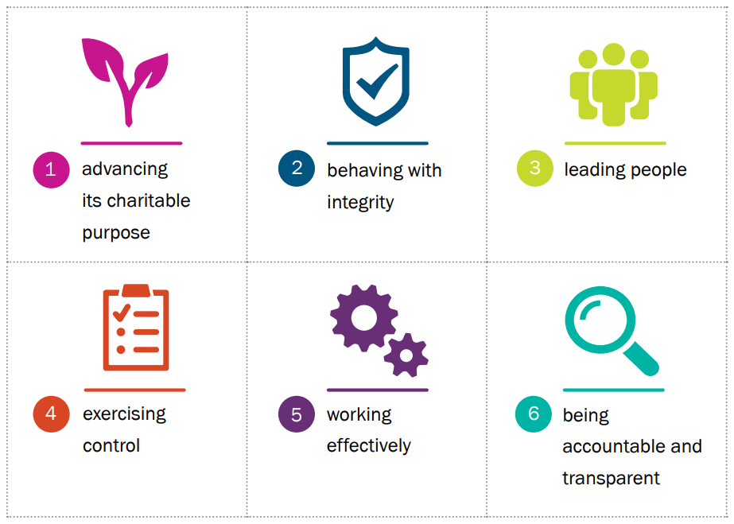
RI - Governance Code
In the Republic of Ireland, the Charities regulator further clarified trustee responsibilities by producing a Governance Code,
While articulated differently in Northern Ireland, the same principles apply.
Addressing these requirements helps trustees know they are compliant.

Slide 7
Timeline
Annual process led by Diocesan Secretaries
Annual report accounting and activity +(RI -on governance compliance),
Date - 31 October every year (for charities with Y/E 31 December)
Viewable on Regulator’s website
Republic of Ireland
Last stage of parish registration will commence autumn 2021.
Northern Ireland
Cross border dioceses are still to be called to register. (Connor and Down & Dromore are already registered.)

Slide 8
Suggested Annual Approach to Charities Governance
General Vestry – set register, meet, elect Select Vestry – role descriptions + for key positions, General Vestry approves previous years accounts & report.
Select Vestry – meets, elect key positions (role descriptions), adopt governance policies by resolution and Safeguarding policies + parish panel.
Select Vestry – induction – what are the responsibilities of a charity trustee.
Select Vestry – budget and strategic plan, insurance, managing people
Select Vestry – risk register.
Select Vestry – Safeguarding – with safety statement and risk review (RI)
PARISH RESOURCES on website – further detail on agendas, minutes, managing parish finances, etc

