Slide 1
THE C of I GOVERNANCE CODE COMPLIANCE & REPORTING
Janet Maxwell – Head of Synod Services & Communications

Slide 2
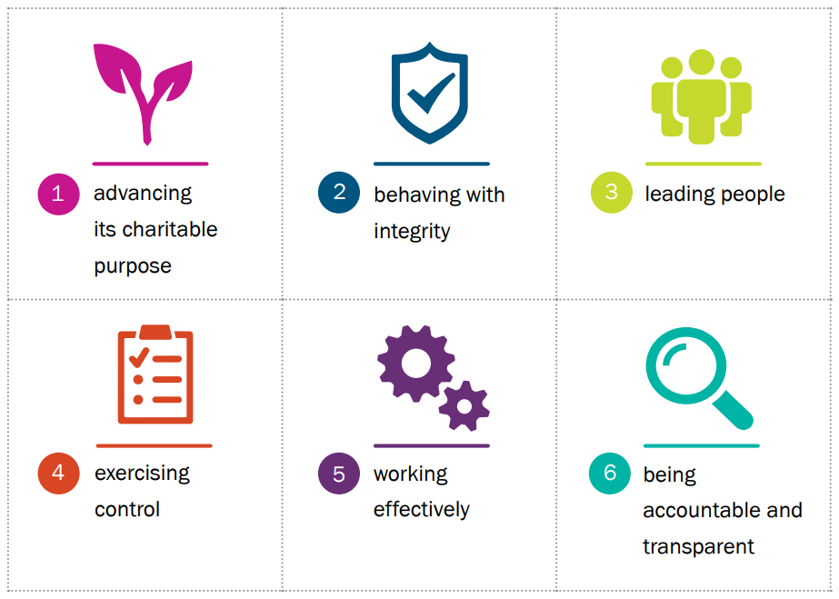
CRA Governance Code

Slide 3
CRA GOVERNANCE CODE FOR SELECT VESTRIES
Based on the Church of Ireland Constitution (Governing Document)
Guidance Documents – Parish Resources
Annual pattern that can be used in all parishes

Slide 4
Suggested Annual Approach to Charities Governance
General Vestry meeting
Election of Select Vestry
Key positions (role descriptions)
Governance policies adopted by resolution
Safeguarding policies - parish panel
Select Vestry – induction training
Planning Step 1: Strategic plan, activity plan and budget
Planning Step 2: Review Risks & Insurance
People
Working effectively
Reporting

Slide 5
Need a bit more help?
PARISH RESOURCES on Church of Ireland website
HELP
GUIDANCE
MODEL DOCUMENTS
www.Ireland.Anglican.org/parish-resources

Slide 6
WHO IS RESPONSIBLE FOR GOVERNANCE?
MEMBERS OF SELECT VESTRIES
TEAM WORK
SUB-COMMITTEES
WORKING TOGETHER, BUILDING ON OUR STRENGTHS

Slide 7
BUT IT’S A LOT OF WORK?
THERE IS SOME ADDITIONAL WORK...

Slide 8
BUT WE’VE ALREADY DONE A LOT OF IT
Governing Document - Constitution
Charitable Purpose & Objects
Agendas & Minutes
Role Descriptions
Insurance
Safeguarding policies & implementation
Governance Policies
Induction training for SV members

Slide 9
And we’re working on other bits....
In progress....
Budgeting
Forward planning & strategic planning
Risk review
Charity accounting formats
Reporting formats around governance

Slide 10
REPORTING FOR YEAR END 2021
Annual Report asks questions related to the Governance Compliance Form Answers
Most Select Vestries have completed some tasks
But developing a full suite of evidenced compliance takes time
MOST PARISHES ARE ‘IN PROGRESS’
IT IS BEST TO BE CAUTIOUS AND NOT DECLARE FULL COMPLIANCE

Slide 11
COMPLEX OR NON-COMPLEX ...a decision for trustees
NON-COMPLEX
Small in size
Relatively low income
Few transactions
Limited activity
Non-complex funding
COMPLEX
Safegarding policies + extensive regulated activity
Complex funding
Significant income
Paid staff
Large in size
Significant number of ‘high-risk’ items on Risk Review

Slide 12
WHAT DOES THE GOVERNANCE REPORTING FORM LOOK LIKE?
MODEL FORM FROM CRA WEBSITE
sample-completed-compliance-record-form-non-complex-charities-final.pdf (charitiesregulator.ie)
MODEL FORM FROM CHURCH OF IRELAND
The Compliance Report form is not uploaded. There are Governance questions on the annual report.

