Slide 1
THE C of I GOVERNANCE CODE COMPLIANCE & REPORTING
Janet Maxwell – Head of Synod Services & Communications
Stuart Wilson – Compliance & Committee Support

Slide 2
CHARITIES GOVERNANCE CODE

Slide 3
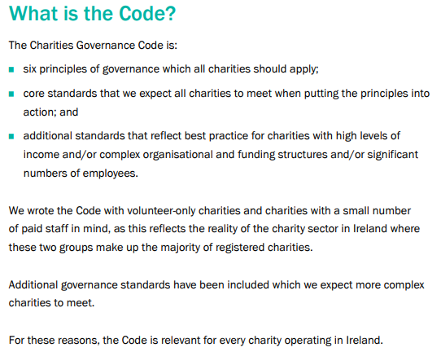
CHARITIES GOVERNANCE CODE

Slide 4
GOVERNANCE CODE IN CONTEXT
For registered parishes:
Governance Code Compliance Record Form helps answer questions asked on the Annual Report.
COMPLIANCE RECORD FORM
TRUSTEES ANNUAL REPORT
PARISH ACCOUNTS (AUDITED or RECEIPTS & PAYMENTS)
ANNUAL REPORT

Slide 5
GOVERNANCE CODE IN CONTEXT
Unregistered parishes:
Many of the policies adopted and other work done to prepare for registration provide a basis for your Compliance Record.
Good chance to get a head start.

Slide 6
GOVERNANCE CODE COMPLIANCE & REPORTING FOR PARISHES
You are NOT required to file the Compliance Record Form itself with the Charities Regulator.
However, you must keep your Compliance Record form as the Charities Regulator could ask you for it at any time.
We recommend the form be kept in your Governance Folder.

Slide 7
GOVERNANCE FOLDER & RECORD KEEPING
Record keeping is an important part of good governance.
Policy documents, minutes, and other important records should be kept and filed for ease of access and later locating.
A central, secure & organised governance folder is a huge asset when reporting on governance compliance.
We recommend a hard copy be kept, in addition to any digital files.

Slide 8
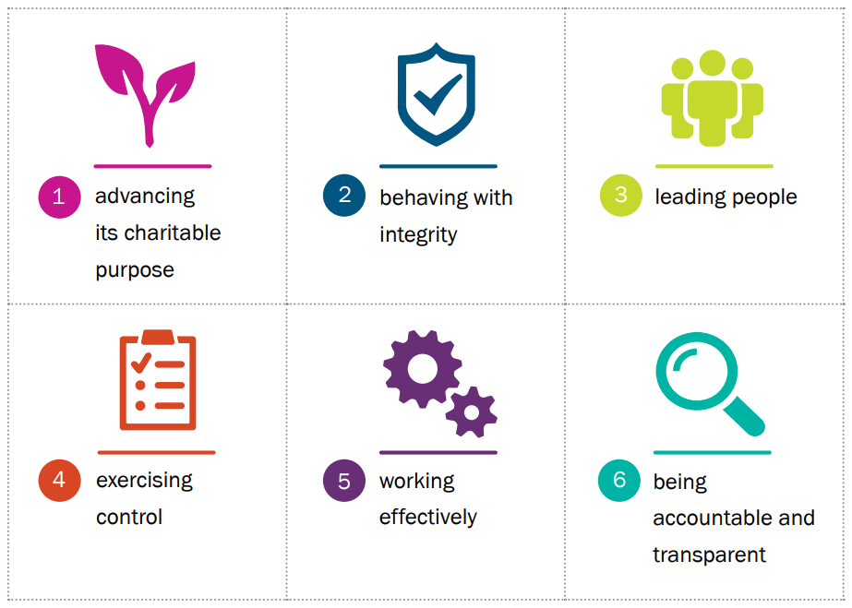
CRA Governance Code: Six Principles
The Charities Governance Compliance Record Form is made up of a series of questions on the Six Principles of the Governance Code.

Slide 9
GOVERNANCE CODE COMPLIANCE & REPORTING FOR PARISHES
Each Principle has a series of Core and Additional Standards associated with it. Questions ask how you meet each standard.
For example:
Principle 1: Advancing Charitable Purpose CORE STANDARDS
1.1 Be clear about the purpose of your charity and be able to explain this in simple terms to anyone who asks.

Slide 10
For each question:
List the actions taken to meet the standard.
For example:
Principle 1: Advancing Charitable Purpose CORE STANDARDS
1.1 Be clear about the purpose of your charity and be able to explain this in simple terms to anyone who asks.
Actions Taken:
Information is provided to trustees who are members of the Select Vestry.
Charitable Purpose for Parishes is outlined in the Church of Ireland Constitution.

Slide 11
For each question:
Provide evidence.
For example:
Actions Taken:
Information is provided to trustees who are members of the Select Vestry.
Charitable Purpose for Parishes is outlined in the Church of Ireland Constitution.
Evidence:
Charity Trustee Training for Select Vestry Members [Dates]
Constitution of the Church of Ireland - Chapter XVII [Link]

Slide 12
Evidence:
All charities should discuss and agree at select vestry meetings how they will meet the standards and minute the decision.
For volunteer-only charities this will be enough to meet many of the core standards.
More complex charities will be expected to provide more extensive documentation than other charities.

Slide 13
Questions: Core and Additional Standards
Principles have Core and Additional standards
All charities are expected to answer the questions on Core standards.
Additional Standards are to be completed by complex charities only.

Slide 14
COMPLEX OR NON-COMPLEX ...a decision for trustees
No strict rule, only indicators.
NON-COMPLEX
Smaller in size
Relatively low income
Few transactions
Limited activity
Non-complex funding
most parishes will be considered non-complex
COMPLEX
Safeguarding policies + extensive regulated activity
Complex funding
Significant income
Paid staff
Larger in size
Significant number of ‘high-risk’ items on Risk Review

Slide 15
Governance: Comply or Explain
Full compliance is not the only option.
For smaller charities, the CRA is more interested in accurately declared compliance than claims to be fully compliant in all areas.
Where you are not currently compliant you should try to understand be able to explain why. It is reasonable to explain that you are working towards compliance.

Slide 16
A Word of Warning…
Full compliance declaration
CRA Spot check

Slide 17
GOVERNANCE CODE COMPLIANCE & REPORTING FOR PARISHES
Compliance Record Form should be approved at a Select Vestry meeting before you report on your compliance to the CRA.

Slide 18
Sample Document:
Parish Resources
Charity Governance Code Reporting (RI)
Parish Governance Code Compliance Record
www.ireland.anglican.org/parish-resources/655/charity-governance-code-reporting-ri

Slide 19
Questions:
Feel free to contact me directly: stuart.wilson@rcbdub.org

