Slide 1
THE CHARITY CLASSIFICATION STANDARD
Janet Maxwell – Head of Synod Services & Communications

Slide 2
BENEFITS OF CLASSIFICATION
Classification allows the register of charities to provide more information on the type of activities a charity is likely to undertake.
Enables the public to find charities they may wish to support more easily.
Helps charities with similar goals to connect with each other and share knowledge.

Slide 3
CHARITY CLASSIFICATION
Self-determined.
Classification does not limit activities.
Provides a guideline, not a restraint.
Notes:
Annual report will always provide space to outline activities taken by the parish, even those “outside” this classification.

Slide 4
WHEN?
Existing registered charities, that pre-date the classification will find a classification form online in their charity portal. Please complete this form.
Newly registering charities will complete classification as part of the registration process.
Notes:
Most parishes will complete classification while registering.

Slide 5
What to do? Choose one or two.
10 primary classifications provided:
Choose at least one of these, may choose a second.
Each primary group has secondary groups:
Pick up to two
Some secondaries contain a further sub-group.
Pick up to two

Slide 6
Example

Slide 7
Example

Slide 8
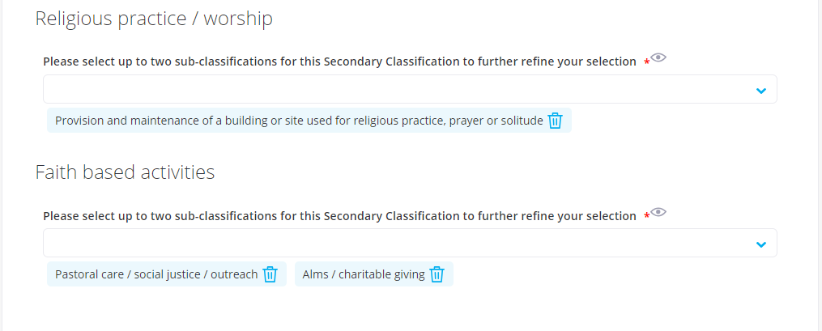
Example

