Slide 1
Representative Body of the Church of Ireland
WELCOME
Ecclesiastical Insurances – Trustee Indemnity Cover
RCB – Preparing for Charities Accounting

Slide 2
Paul Collins – Ecclesiastical Insurance
The contact details for Ecclesiastical Church Team are:
Stephanie Campbell, Senior Underwriter
Ph: 01 619 0324 stephanie.campbell@ecclesiastical.com
Emma Fitzpatrick, Underwriter
Ph: 01 619 0353 emma.fitzpatrick@ecclesiastical.com

Slide 3
Representative Church Body of the Church of Ireland
Parish Treasurers
Preparing your Parish for Charities Accounting
Seminar III – 2022 (I - 2015, II - 2018)
Kate Williams
RCB

Slide 4
Agenda
Trustee responsibilities
RCB & local supports
2009 Charities Act and Revenue rules
Thresholds
New concepts for the future of Independent Examination
Audit
What are “Receipts & Payments” and “Accrual” accounts
How to account for your Parish, Group or Union
Explaining restricted & unrestricted funds
What is the statement of Assets & Liabilities and Balance Sheets?
Accounting for Church Property
Accounting for Parish Investments
Watch out for

Slide 5
Role of annual accounts and reporting
Charities are required to
Build trust
Provide more information
Be more transparent
CRA Function
Increase public trust
Build confidence in the charity sector
Ensure accountability
Accounting
&
Reporting

Slide 6
Accounting for your Parish as a registered charity
Trustees are responsible for:
keeping proper books of account
Prepare annual statements of accounts
Ensuring they comply with audit obligations as required
Prepare an annual report
The parish trustees are the members of the Select Vestry of the Parish, Group or Union
The trustees must keep either receipts & payment accounts or accrual accounts in line with thresholds

Slide 7
There is a range of RCB & local supports
RCB providing guidance & support on the charities registration process via synod office
RCB finance department have developed a series of supports for Parishes which are available on the Church of Ireland website under parish resources/parish finances
Example Receipts & Payment Accounts
Explanatory Notes on receipts & payment accounts
Glossary of terms for receipts & payment accounts
Example SORP compliant accrual accounts
Explanatory notes on SORP compliant accrual accounts
Glossary of terms for SORP compliant accrual accounts
Guidance on accounting for Church property

Slide 8
RCB & local supports (continued)
Treasurers networks – Diocese are encouraged to support the formation of local treasurer networks to share learnings
Select Vestries are encouraged to seek out local resources & experts in Parish to support with email, new format of accounts, charities reporting, etc.
RCB Parish seminars (2015, 2018 & 2022)
RCB Parish Resource - (www.ireland.anglican.org/parish-resources/parish-finances)
SV encouraged to set up a Parish email address for communicating with the regulators office & the RCB (htdunshaughlin@gmail.com)

Slide 9
Legislation & Thresholds
What is the current position
New regulations
New concepts

Slide 10
Current position – The 2009 Charities Act & Revenue rules
Charities with income or expenditure in excess of €100,000 are required to prepare audited accounts
Charities with income or expenditure less than €100,000 can prepare simplified accounts
New thresholds have been recommended by the Charities Regulatory Authority in the 2016 Regulations, however, we are still waiting for the legislation to be enacted.
The CRA Head of Compliance has noted the CRA would expect charities to be compliant with the law

Slide 11
Income threshold under the 2009 Charities Act & Revenue rules
Requirements | 2009 Act
Preparation of full accrual accounts which must be audited comprising of Statement of Financial Activities, Balance Sheet, Cash flow and notes | Gross income / expenditure > €100,000
Preparation of simplified accounts comprising of a statement of receipts & payments and statement of assets & liabilities | Gross income / expenditure between €10,001 and €100,000
No requirement to file accounts with CRA or to have accounts audited | Gross income / expenditure < €10,000

Slide 12
Income thresholds – Recommended in 2016 Regulations
Requirements | 2016 Regulations – not in law yet
Charities with income of €250,000+ | Trustees prepare FRS 102 accrual accounts to be independently audited by a professional auditor Statement of financial activities, Balance sheet, Cash flow statement and notes to the accounts
Charities with income more than €25,001 but less than €250,000 | Trustees prepare receipts and payments accounts to be independently examined Statement of Receipts and Payments, Statement of Assets & Liabilities and notes to the accounts
Lower threshold - €25,000 or under | Minimal reporting – annual return and no requirement to file accounts with the CRA

Slide 13
We’ll let you know when these new rule apply

Slide 14
While an audit may not be required below specific income thresholds
Governing documents or Diocesan rules may require Parishes to audit financial statements
Funding providers e.g. government grants may require financial statements to be audited as part of funding requirements
An audit requires the appointment of an independent auditor or firm of auditors who give an independent opinion on the financial position of the entity.

Slide 15
The 2016 Regulations (not enacted ) introduce the new concept of “Independent Examination”
Where the income threshold is less than €250,000 the concept of independently examination is introduced
Independent Reviewer of Charity Accounts:
An independent person who, in the reasonable opinion of the Select Vestry (Trustees), has the requisite ability and practical experience to carry out a competent review of the accounts.
If on an accrual basis – reviewer must be a member of a relevant professional body – i.e. accountancy body
Format/content of independent reviewer’s report specified in the regulations.
Important that there is no conflict of interest between a member of the trustees and the independent examiner.

Slide 16
Audit
Current audit threshold under Revenue rules - income or expenditure of €100,000 or more
Audit opinion provided and included in the financial statements
Tends to be expensive – costs will vary depending on size of Parish

Slide 17
Calling forward for registration with the CRA
Parishes registering with the CRA will require a charity number (CHY) from the Revenue Commissioners
Revenue will request a set of the latest financial statements and will note if income or expenditure is greater than €100,000 accounts should be audited
It is the intention to call forward Parishes under the €100,000 threshold in the first tranche of Parishes to registrations
The RCB will work with Diocese to identify Parishes who fall into this category
Those over €100,000 will be called forward in the second tranche

Slide 18
Transitioning – what type of accounts to prepare and for what?
Receipt & Payment Accounts Accrual Accounts Accounting entity – the unit

Slide 19
Receipts & Payments Accounts
Simpler form of accounts based on money received and paid both through the bank /cash accounts for the financial period/year
Best practice is to include a statement of assets & liabilities and notes to the financial statements
Financial statements should be signed by two trustees
Future looking - When new regulations are enacted the majority of Parishes will fall within receipts & payment accounts thresholds (i.e. under €250,000) but there will be a requirement to have an independent examination

Slide 20
Accrual Accounts
Here the income or expense of a particular activity is accounted for when the liability is incurred or when there is an entitlement to certain income
Uses the concept of accruals to account for expenses not paid – but the work was completed in the financial period e.g. repairs work carried out but not invoiced would be accrued into the financial statements
Uses the concept of prepayments to bring in income not received but due in the financial period e.g. donation made on 31st December not received until next accounting period would be taken into the financial statements as a prepayment

Slide 21
Parish, Group or Union – what unit do we prepare accounts for?
Entity | Select Vestry | Prepare
Single Parish with a CRN number | One Select Vestry - registered as one charity with CRA | Prepare financial statements for the single parish
Group of Parishes each with their own CRN number | Each Parish in Group will have Select Vestry and each Parish in group will be registered with the CRA | Prepare financial statements for each Parish within the Group
Union of Parishes which are all registered under the one CRN number | The Union will have one Select Vestry and will be registered as one unit with CRA | Prepare one set of financial statements for the Union of Parishes - may mean separate Parish accounts will be consolidated into one set of FS

Slide 22
Transitioning – what to include in your Parish accounts?
Types of funds Balance Sheet or Statement of Assets & Liabilities Church Property Parish Investments

Slide 23
Restricted and Unrestricted Funds
Restricted Funds
Funds received for a specific appeal and which can only be used for that specific purpose – Church roof repair fund
Unrestricted Funds
Income arising which can be used for general Parish purposes
Endowment Funds
Funds donated or bequest made which can be either restricted or unrestricted and either permanent or expendable.

Slide 24
 | Note | Unrestricted Funds 20xx £ |  | Restricted Funds 20xx £ |  | Endowment Funds 20xx £ |  | Total 20xx £ |  | Total 20xy £
Receipts
Donations & plate collection Proceeds from Fund Raising Events
Legacies
Bank & Deposit interest
Investment income
Rental of premises
Sale of assets
Sale of investments
Grants
Receipts from General Trustees
Other Receipts Receipts from Parish Organisation’s
Total Receipts
Example of receipts and payments accounts by fund

Slide 25
Statement of Assets & Liabilities and Balance Sheet
Most Parishes won’t have produced a statement of assets & liabilities or a Balance Sheet
What should be included:
Fixed Assets – The RCB has produced guidance for Parishes on how to value church property (Church, Grave yard, Parish hall, Rectory & any land)
Investment – held in trust or managed by the RB in the General unit trust or other investments
Cash – held by the RB
Bank – all bank accounts
Debtors – amounts due to be collected which have not been received but are included in the accounts (Accrual accounts only)
Creditors e.g. suppliers or money owed which has not been paid but due (Accrual accounts only)
Bank Loans – any loan from banks or other financial institutes
The Statement of Assets & Liabilities is less onerous
Full Balance Sheet is more complex

Slide 26
Statement of Assets & Liabilities
 |  | Unrestricted Funds 20xx £ | Restricted Funds 20xx £ | Endowment Funds 20xx £ | Total 20xx £ | Total 20xx £
Cash Funds
Current Accounts
Deposit Accounts
Total Cash Funds
Investment Assets
Equity Investments
Other Listed Investments
Investments in RCB / CIT Unit Trusts
Other unlisted investments
Investment Properties
Total Investment Assets
Assets retained for the Parish’s own use
Parish Centre
Glebe House
Fixtures and Fittings
Total Assets retained for the Parish’s own use

Slide 27
Accounting for church property
RCB holds Parish property and land in trust for the Church of Ireland
Property includes – Churches, Graveyards, Glebes, Glebe Land, Parish Halls and other Parish properties
Where the property is vested in the RCB the property should be included in the Parish statement of assets & liabilities
Where the property is vested in the Parish, then the property should be included in the Parish statement of assets & liabilities
Where the property is vested in individual or independent trustee these circumstances will need to be considered individually

Slide 28
Church properties
Church property | Valuation
Historic Churches & Graveyards | Can be recognised as a “heritage asset” and where its cost or valuation is not available no value need be ascribed in the statement of assets & liabilities but a note needs to be included
Churches built in latter part of twentieth century | Can be recognised as a “heritage asset” however, where costs are available a value will be ascribed in the statement of assets & liabilities to the property

Slide 29
Church properties
Church property | Valuation
Parish Halls / Centres Option 1 - Is physically attached to Church | Can be deemed a “heritage asset” – refer to accounting treatment above of Church property deemed heritage asset
Parish Halls / Centres Option 2 - Is not physically attached to Church and no reliable record of cost exists | A value should be ascribed, however, if parish hall was built at a time when no reliable record of costs of construction or acquisition exists then no value need be ascribed
Parish Halls / Centres Option 3 - Is not physically attached to Church and a reliable record of cost exists | A value should be ascribed where a reliable record of cost of construction or acquisition exists. The parish hall will be recognised in the statement of assets & liabilities or the Balance Sheet at the cost of construction or acquisition.

Slide 30
Church properties
Church property | Valuation
Glebe Option 1 - Which stand on their own grounds and could be placed on the open market or sold separately | Record in statement of assets & liabilities at cost or deemed cost. Cost is cost of construction or acquisition. Deemed cost might be the valuation placed on the property for local property tax valuation or rateable valuation
Glebe Option 2 - Which stand within the grounds of the Church &/or graveyard and could be placed on the open market or sold separately | Record in statement of assets & liabilities or Balance Sheet at cost or deemed cost. Cost is cost of construction or acquisition. Deemed cost might be the valuation placed on the property for local property tax valuation or rateable valuation
Glebe Option 3 - Which stand within the grounds of the Church &/or graveyard and could not be placed on the open market or sold separately | These properties should be ascribed a value in the statement of assets & liabilities or Balance Sheet. However, where no reliable record of cost of construction or acquisition exist and a valuation of such a property would lack sufficient reliability, then no value need be ascribed in the accounts.

Slide 31
Church properties
Church property | Valuation
Glebe lands | May be valued at the market value of an acre of land in the area.
Depreciation on Church Hall or Glebe | The select vestry may not need to provide for depreciation where it deems: The SV maintains the property in good repair The current estimated residual value is not less than the carrying value / book cost The remaining useful life of the building exceeds 50 years
Please note insurance valuations of your property is a separate matter and you will need to discuss insurance valuations with your insurance broker

Slide 32
Parish investments
Parish Investment | Valuation
Externally managed parish investments should be included in the statement of assets & liabilities Who might external fund managers be: RCB General Unit Trust ROI or NI Church of Ireland Trustees (NI only) Shares Independently held Where the investments are held in trust by the RCB a note should be included on the statement of assets and liabilities or the balance sheet to note that specific investments or funds are held in trust by the RB | Valuation to be included on Statement of Assets & Liabilities or Balance Sheet will be the market value of the investments at the year end The external investment manager (RCB/CIT/other) will be able to provide a year end market valuation per unit RCB General Unit Trust Investments Investment valuations may be obtained from the RCB for the Parish year end accounts after year end The Church of Ireland web site under Parish resources provides a facility for a Parish to value its own investments and obtain a valuation immediately

Slide 33
Transitioning – watch out for
Parish bank accounts
Payments to employees or other
Cyber crime
Parish Resources

Slide 34
Parish Bank Accounts
Parishes historically have produced accounts for each bank account held on a receipts and payments basis.
Going forward need to bring all accounts into one set of Parish accounts.
Need for Parish organisations to produce accounts for the same accounting period (i.e. all tie in with the same year end date).
Include activities which are part of the parish e.g. choir, active retirement group, flower club.
Organisation with national head-quarters should not be included in your Parish accounts e.g. Boys Brigade, Girls Friendly Society, Girls Brigade, Mothers Union, these organisations will produce separate accounts.

Slide 35
Parish Payments
Parish employees are those who are employed under a contract of employment and who are paid a gross salary with PAYE & related taxes deducted and remitted to Revenue by the Parish
Clergy paid centrally by the RCB are office holders and not deemed to be employees
Gift vouchers up to a maximum of €500 can be paid to an employee
Out of pocket expenses paid to volunteers should be vouched by a receipt
Honoraria payments should be dealt with by the individual receiving the payment in their annual tax returns

Slide 36
Cyber Fraud
Cyber criminal activity has increased significantly
Be careful if you get an email to advise of a change to a bank account for a supplier or contractor – always make a person to person phone call to the person to confirm the change is genuine
Be aware of suspicious looking emails pertaining to come from someone you know asking you to transfer funds urgently – don’t do it!– make a phone call first
Be aware of phishing emails asking you to click on links

Slide 37
Finally
The RCB will be working with Diocese to call forward parishes for registration and your Diocese will communicate with you
You should assess the parish income and expenditure to establish if Parish will fall under or over €100,000 income & expenditure threshold
You should have a look on Parish resources for the sample accounts and guidance notes
Seek out local support if you need guidance
Recommend Parishes commence to transition to the sample receipts and payments accounts

Slide 38
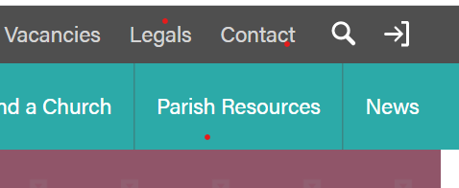
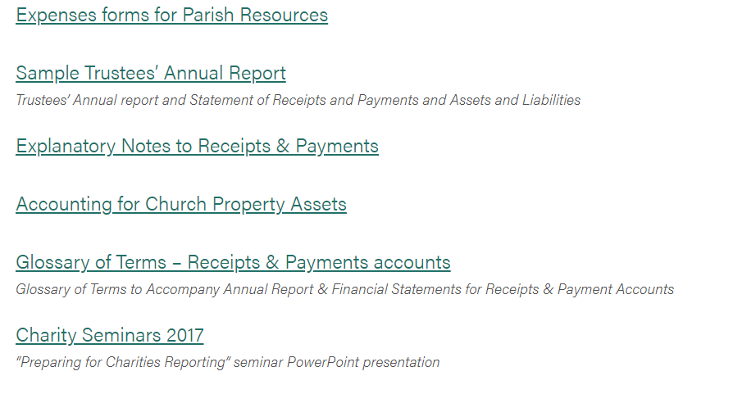

Slide 39
Thank you & any questions
Hopefully this will be child's play

